Slide 1
Transformer Optimization with Data-Driven Insights
- Karan Kalra

Slide 2
Contents
Purpose and problem statement
Tools used
Exploring every corner possible
Is there a problem?
What else can we do?
Prediction and Classification
Results
Future Scopes

Slide 3
Purpose and Problem Statement
The purpose is to analyze and understand transformer characteristics and operational data to,
Identify trends
Gather insights
Identify relations
There are two problem statements I focused on,
Forecasting Transformer load
Identify high-risk transformers with failure prediction

Slide 4



Tools Used
ALTERYX, for Data exploration and cleaning
TABLEAU, for Data Visualization
PYTHON, for Data visualization and prediction modeling

Slide 5
Exploring every corner possible
Data cleaning emphasized on identifying and dealing with duplicates, missing values, outliers, separating & extracting the numerical data for use.
The most important features for the analysis were,
Number of customers
Transformer rating
Phases
Classification
Year of installation
PCB
Bonus features added - AGE OF TRANSFOMER AND CUSTOMER DENSITY i.e. Transformer rating per number of customer

Slide 6
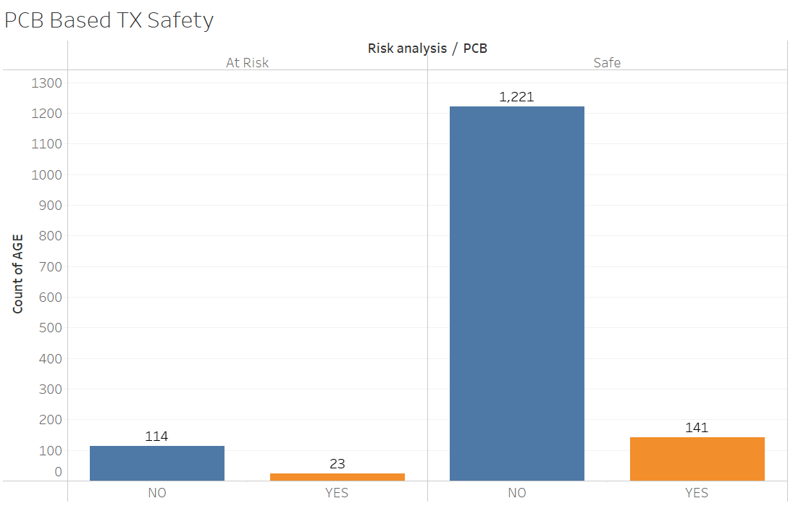
Let’s continue exploring..
Threshold of the Transformer age is 20 years.
Majority lie in safe category but 137 out of 1,499 are in the unsafe category.
8.7% transformers are at risk.

Slide 7
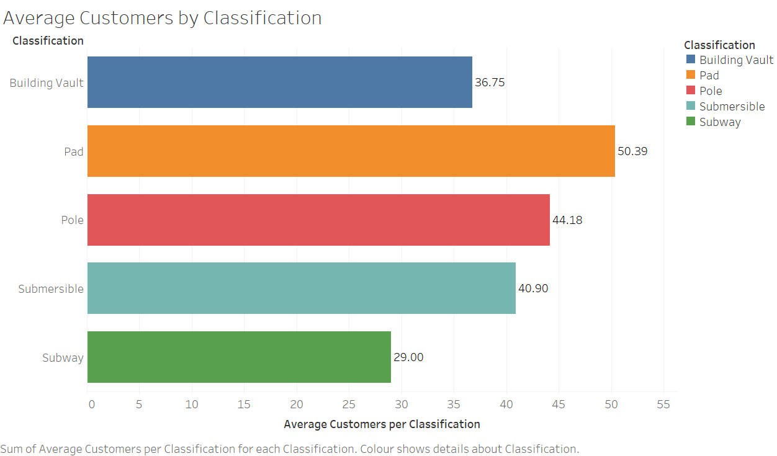
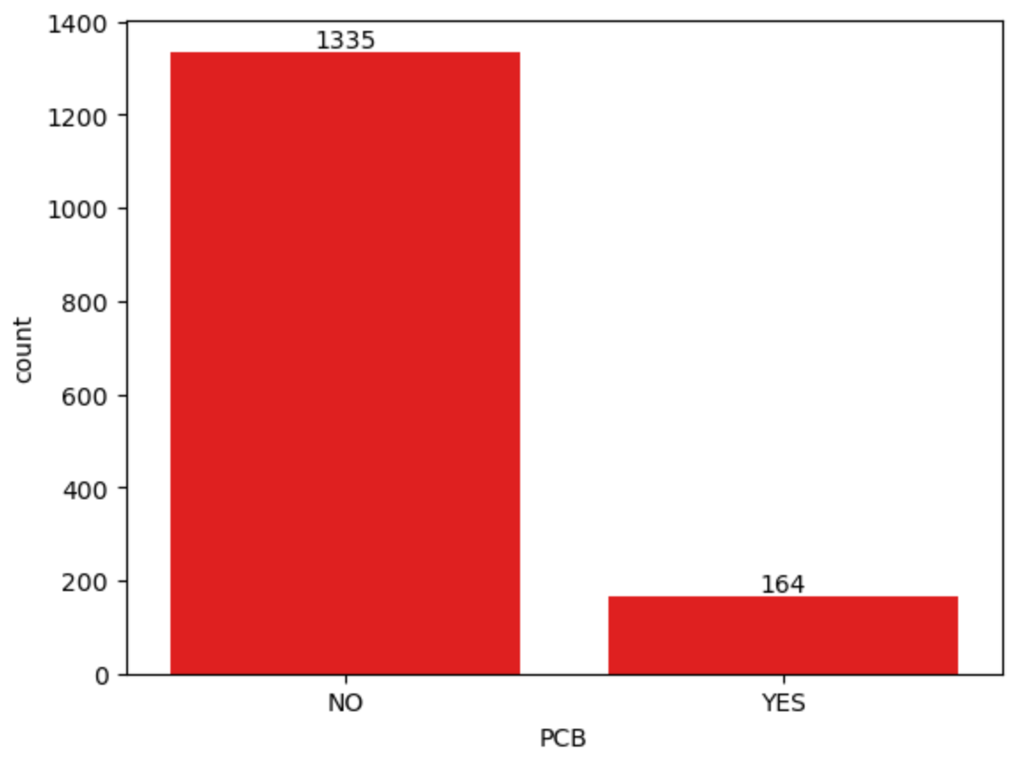
Still exploring..
Distribution of customers by types of transformers
There are 1,335 transformers containing PCBs and 164 not containing PCB.

Slide 8
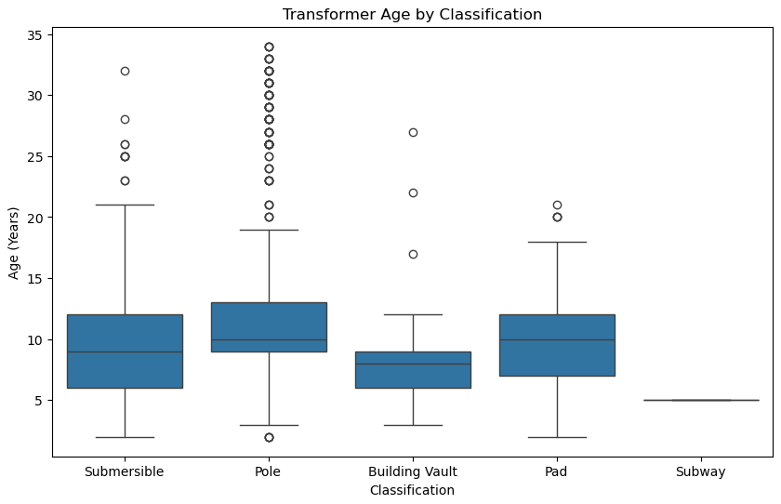
Still exploring..
Insights after leaving outliers -
Peak installation year: 2014
Peak installation count: 203
Oldest transformer age: 34
Youngest transformer age: 2
Avg transformer age: 10.929836995038979

Slide 9
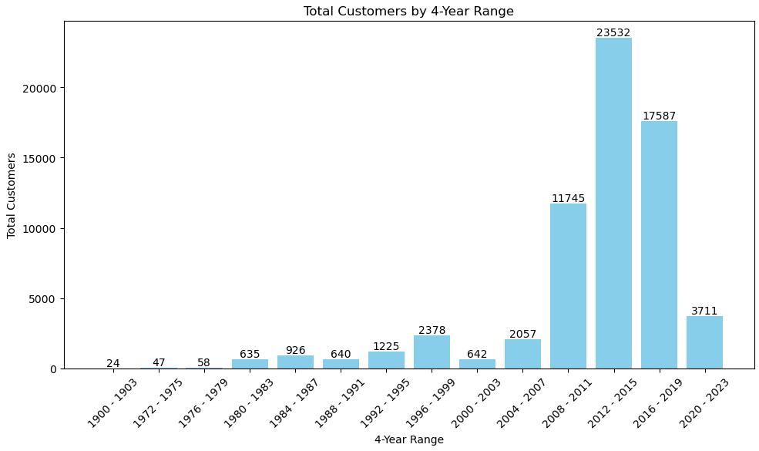
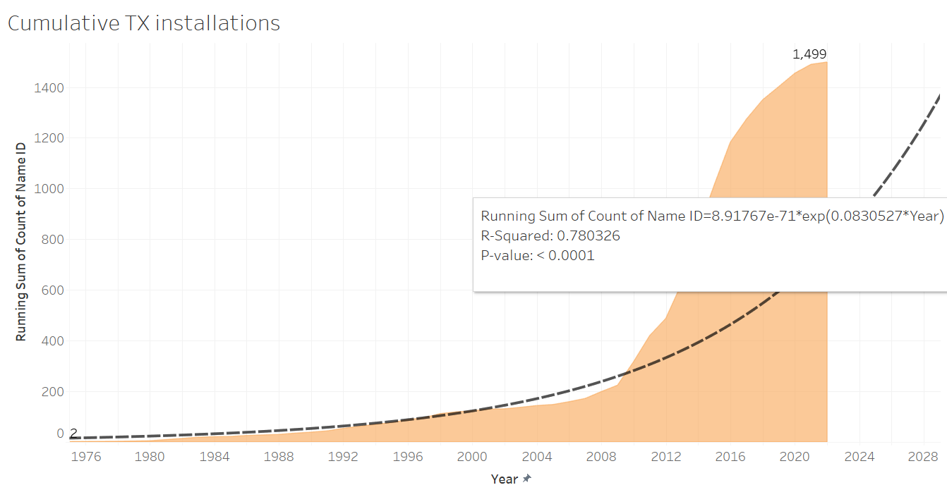
What’s this though?
The sudden rise in number of customers increase load on the transformers. Is it healthy or can that increase the risk ? The increased number of customer per transformer skews the data towards right which makes it unbalanced.

Slide 10
Is there a problem?
YES, THERE IS.
Every other feature has been distributed normally but,
NUMBER OF CUSTOMERS PER TRANSFORMER HAVE BEEN INFREQUENTLY RISING SINCE 2000.
This can create a large amount of load on the transformers and can fail if not maintained.

Slide 11
What else can we do?
We can do a lot my friend, but it depends on extent of your limitations.
Here comes, Machine learning and Deep learning with Neural Networks,
We will predict transformer load based on number of customers.
Further, we will also identify the transformers that can fail soon based on current trends.

Slide 12
Prediction and Classification
We split the data into 80% to train and 20% to test.
All the data in numerical and is divided into features and targets.
Our main goal is to identify the effect of features on the target.
We implement Machine Learning and Deep Learning to get those prediction as accurate as possible.

Slide 13
Prediction
What?
Regression – to identify relationships between variables in data and predict future outcomes. In this case, Transformer overload prediction
Why We Did It?
To enhance transformer management by accurately predicting load, preventing it, and optimizing resource allocation.
What Were the Results?
Numerical features relate to Number of customers well, as the models performed with high accuracy scores:
Random Forest Regressor -
Gradient Boosting Regressor -
This indicates that the model fits the data very well and accurately captures the relationships between the features and the target (No. of customers).

Slide 14
There’s more?!
Hang in there!!

Slide 15
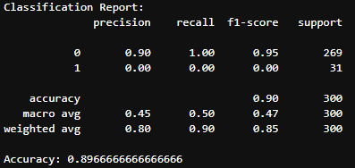
Classification using Deep Learning
What?
Neural networks scalability with feature learning which is suited for complex and deep analysis without using manual feature engineering. In this case, Transformer failure prediction, ‘Failure’ is a new feature.
Why We Did It?
To proactively identify potential failures and guide preventive maintenance.
Enhance decision-making for operational reliability and cost-saving measures.
What Were the Results?
The target with Failure as a new feature indicated, 1 for failure and 0 for not failing
The model was able to predict 90% accuracy
90% accuracy in the context of failure prediction with a neural network means that the model correctly identifies whether a transformer is at risk of failure or safe in 90% of the cases in the test set.

Slide 16
RESULTS - 1
With accurate model prediction under transformers overload we found that the number of customers is overfitting each TX,
Needs optimal resource allocation, optimize TX usage, and maintenance schedules for improved reliability and efficiency

Slide 17
RESULTS - 2
With accurate model prediction under transformers failure, we found the key indicators of TX with possible failure,
Also providing actionable insights for scheduling proactive maintenance, and effectively handling both high-risk and safe cases, to avoid overlooking potential failures.

Slide 18
Future Scopes
Real-time failure risk monitoring
Integration with IoT sensor data
Predictive maintenance scheduling optimization
Expansion to regional risk analysis
Develop load balancing strategies

Slide 19
Thank
you!

